Slide 1

EPL 498: Mobile Computing and Applications
luxzio
Christodoulos Constantinou
Anastasios Chatzikyriakou
Michail Michail

Slide 2
What is luxzio?

Slide 3
luxzio’s Design Choices
Minimalistic three-color combination used throughout the app’s layouts
Logo designed by us that follows the same theme
Use of modern app design patterns and characteristics

Slide 4
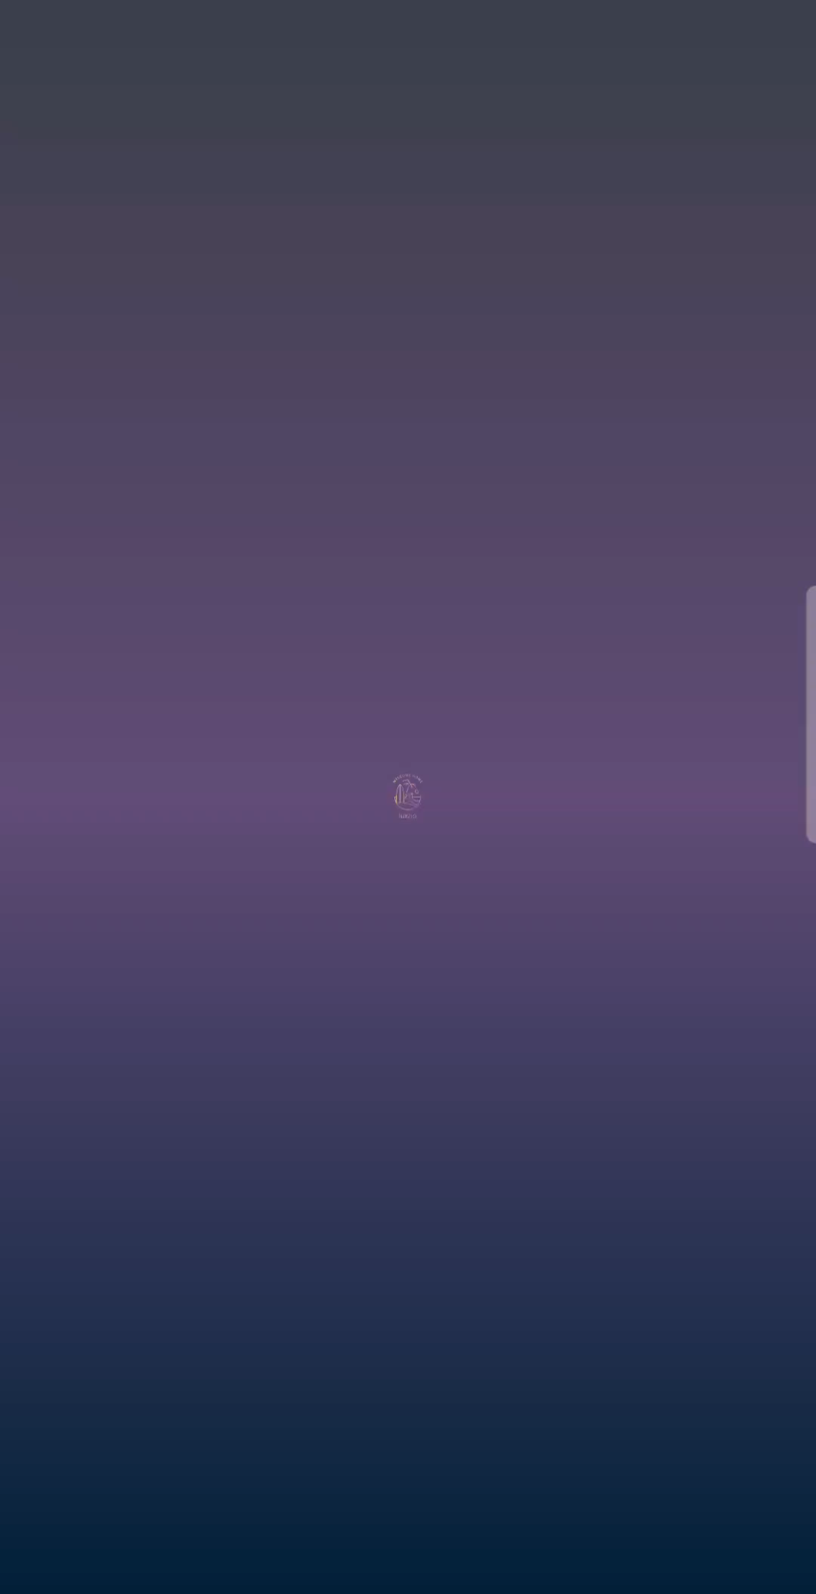
Splash Screen when launching the app

Slide 5
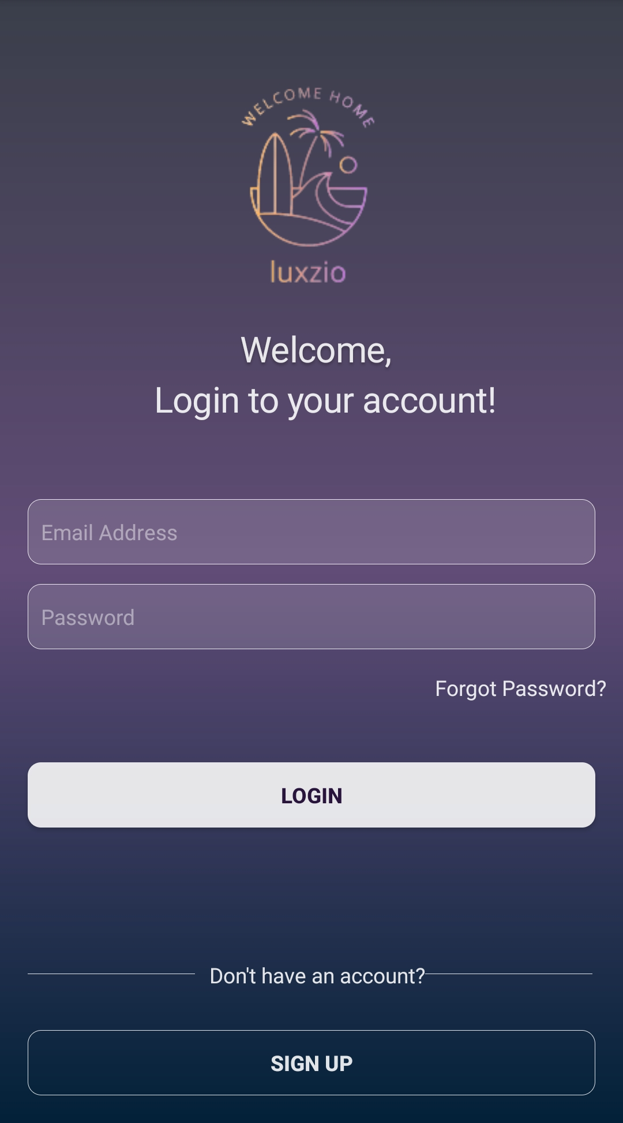
Login Screen

Slide 6
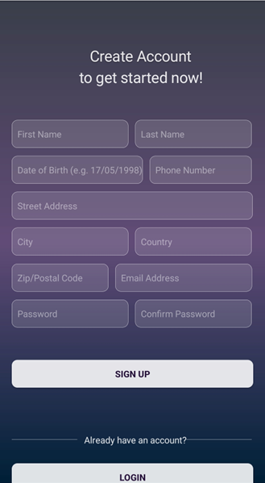
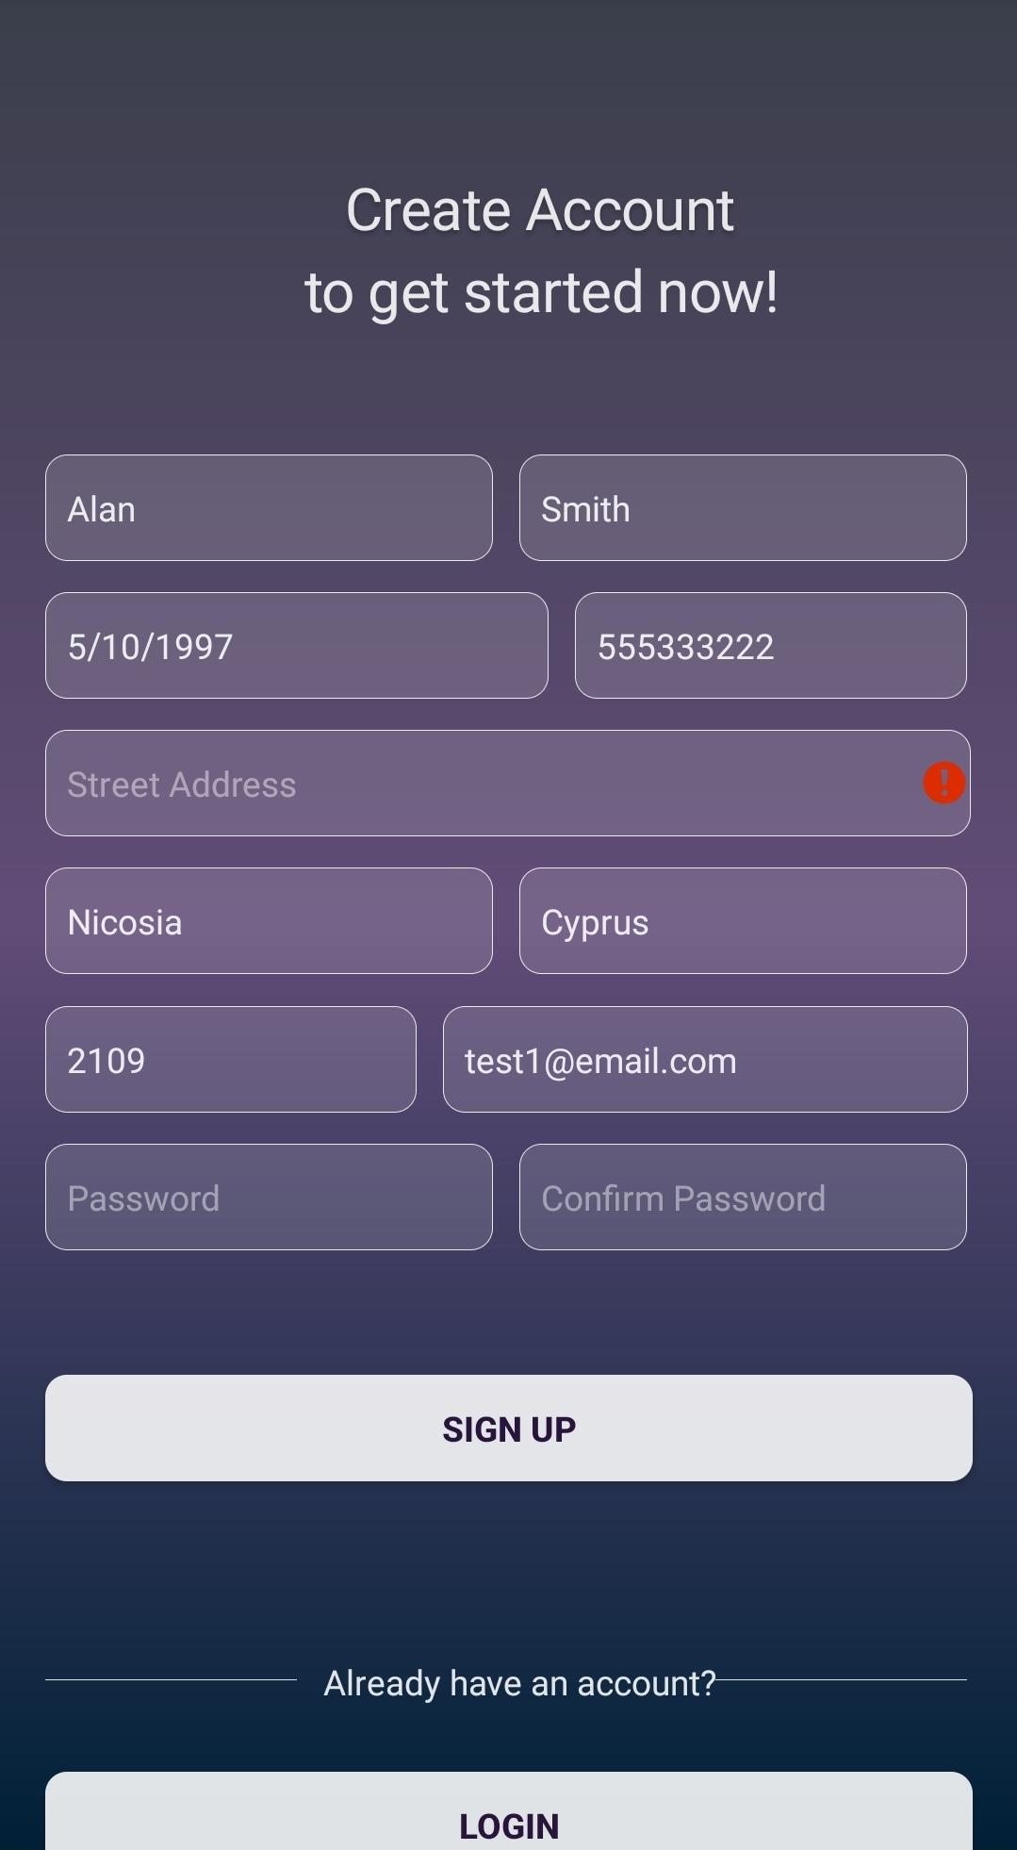
Sign Up Screen
Fields left empty when tapping SIGN UP are marked as required fields (warning label)

Slide 7
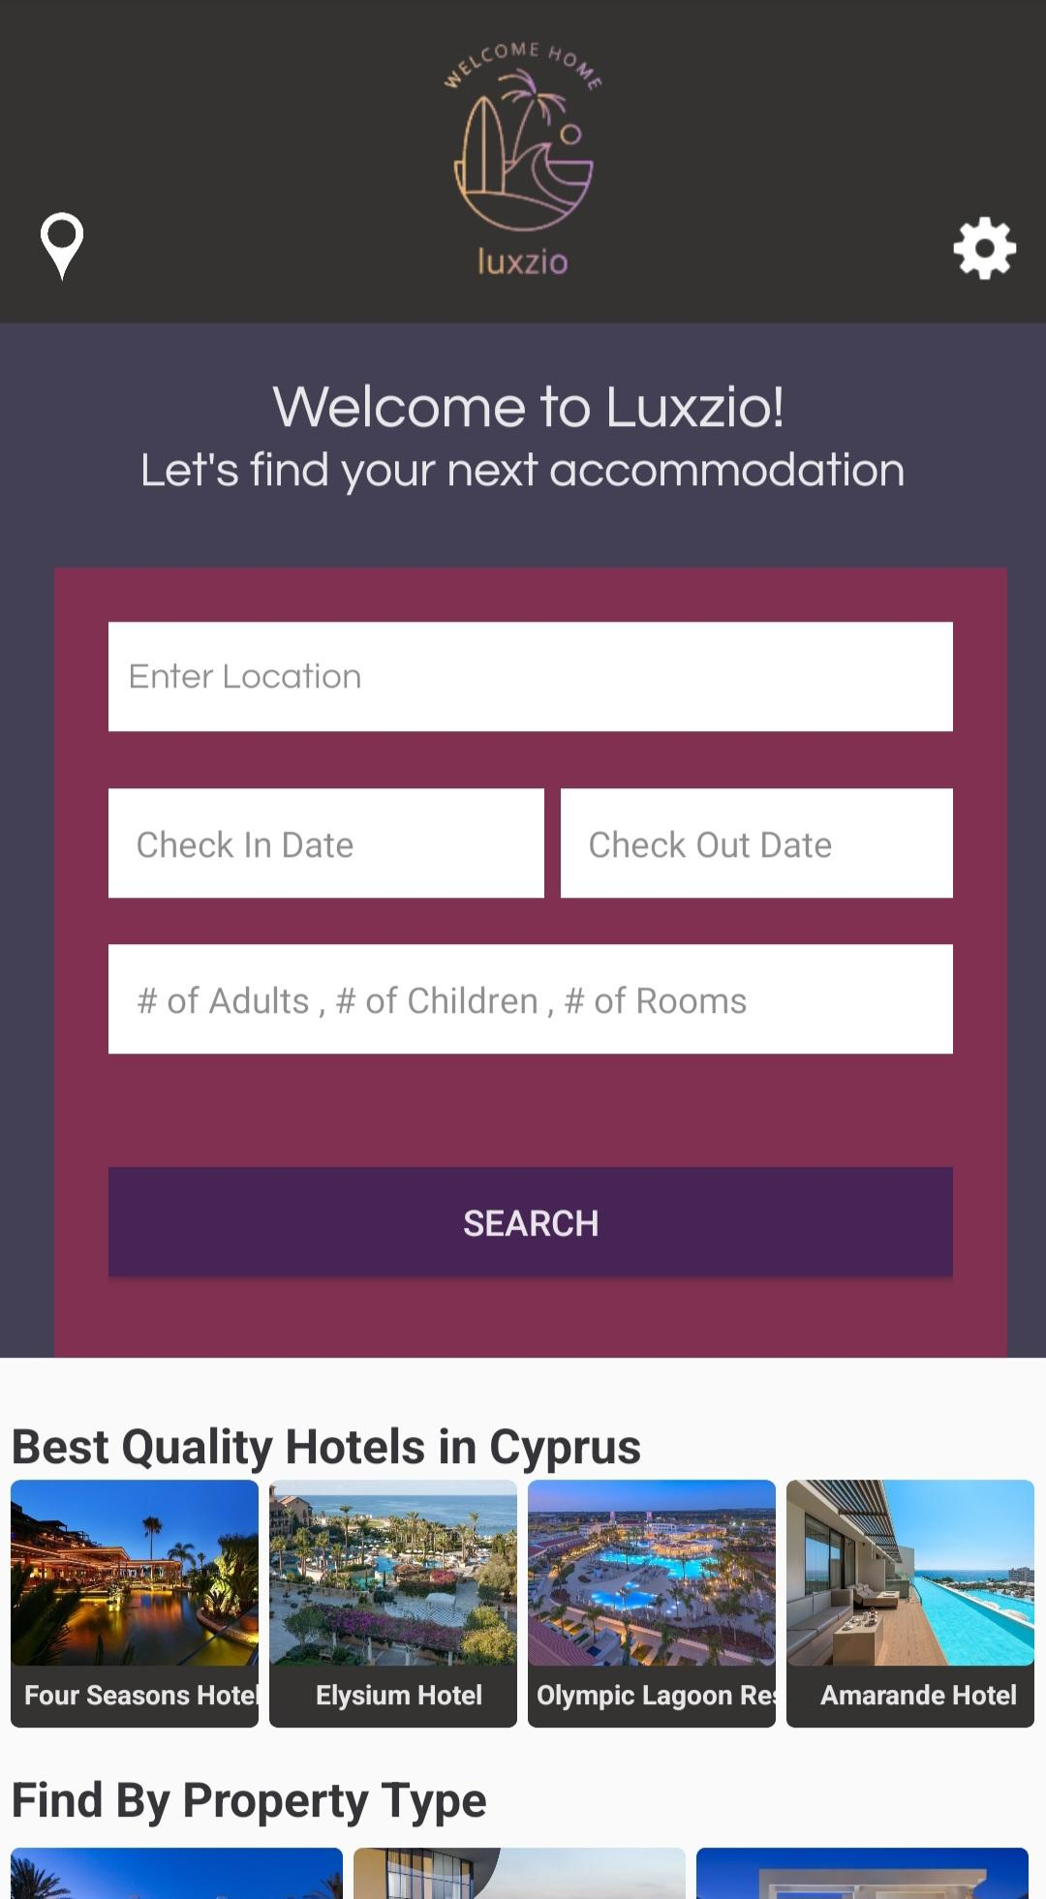
Home Page Screen
Contains:
Accommodation Search Form
Best Quality Hotels Section
Find By Property Section

Slide 8
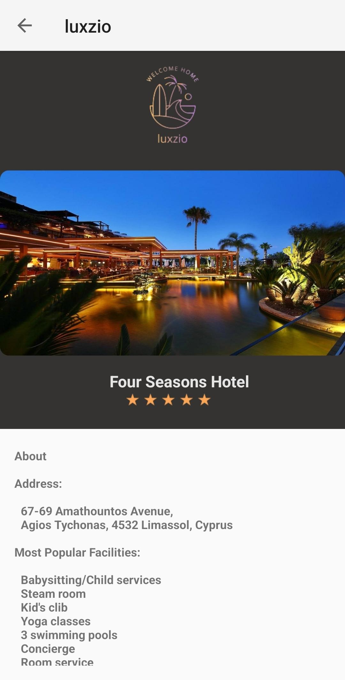
About Page Screen
View hotel rating and more detailed information for a specific accommodation

Slide 9
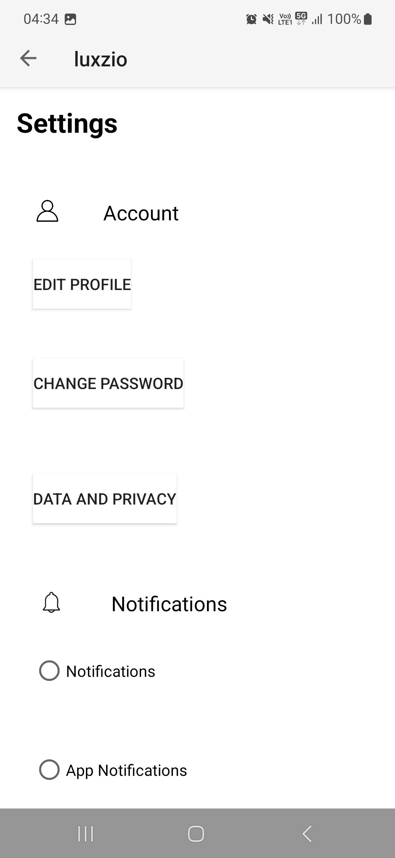
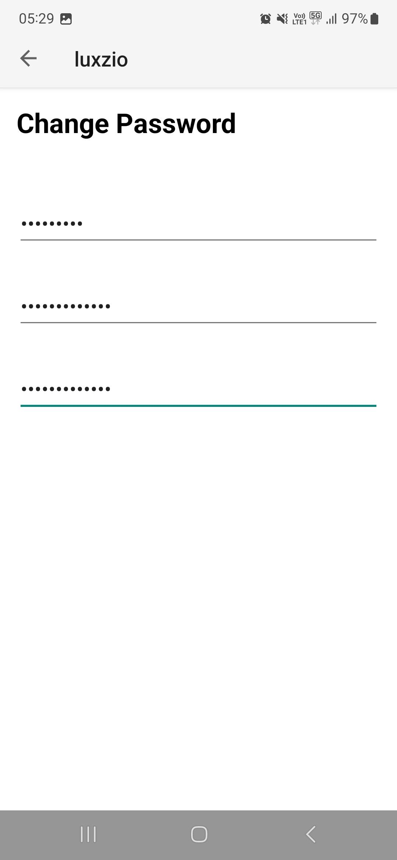
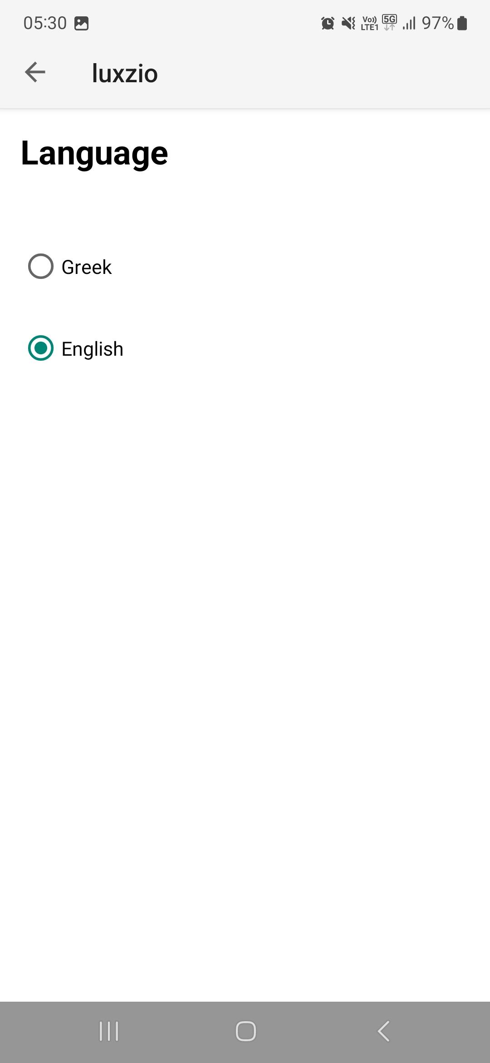
Settings Page Screen

Slide 10
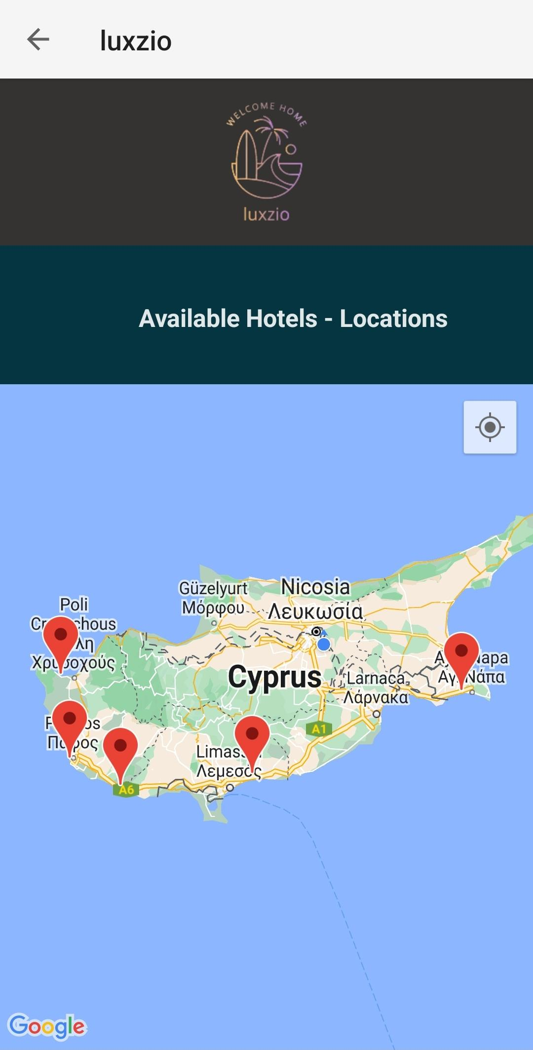
Map View Screen
Accessible through pin location icon

Slide 11
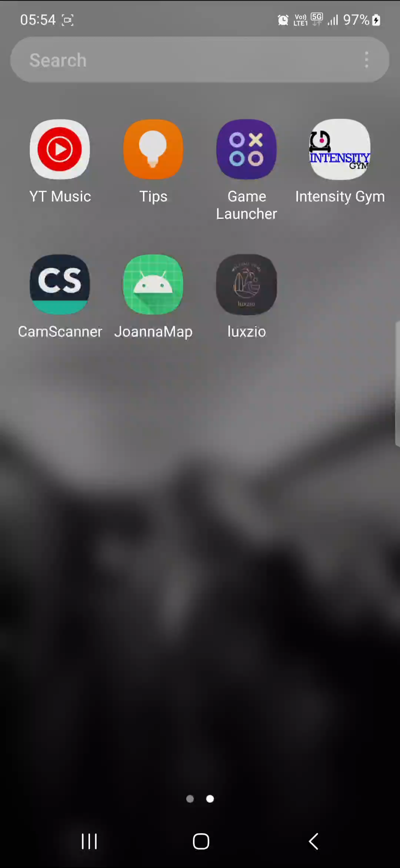
Push Notifications
Push Notifications notify users for new offers

Slide 12
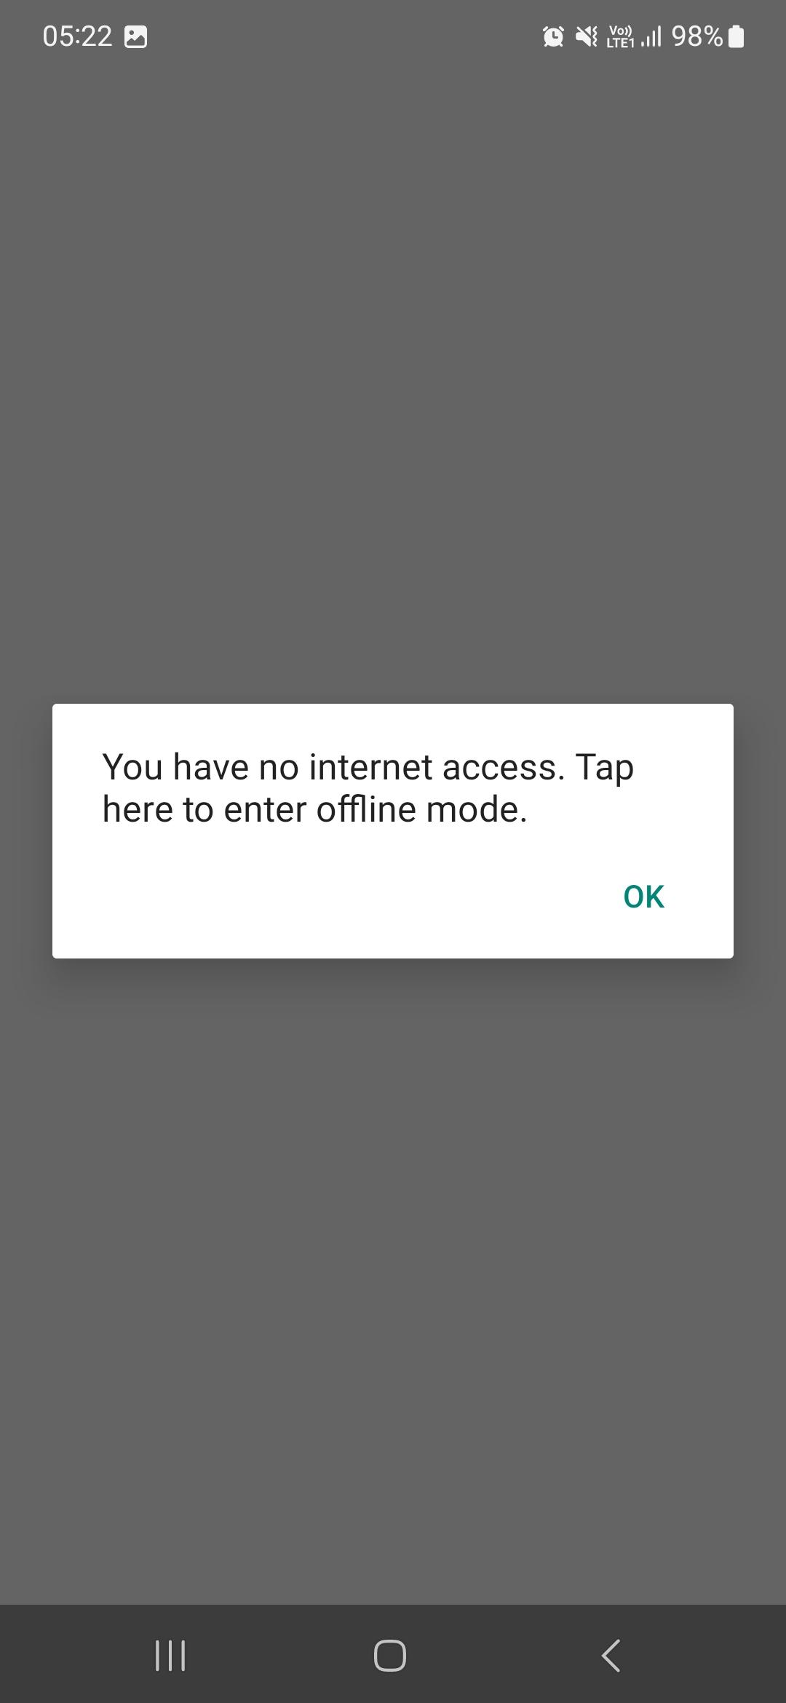
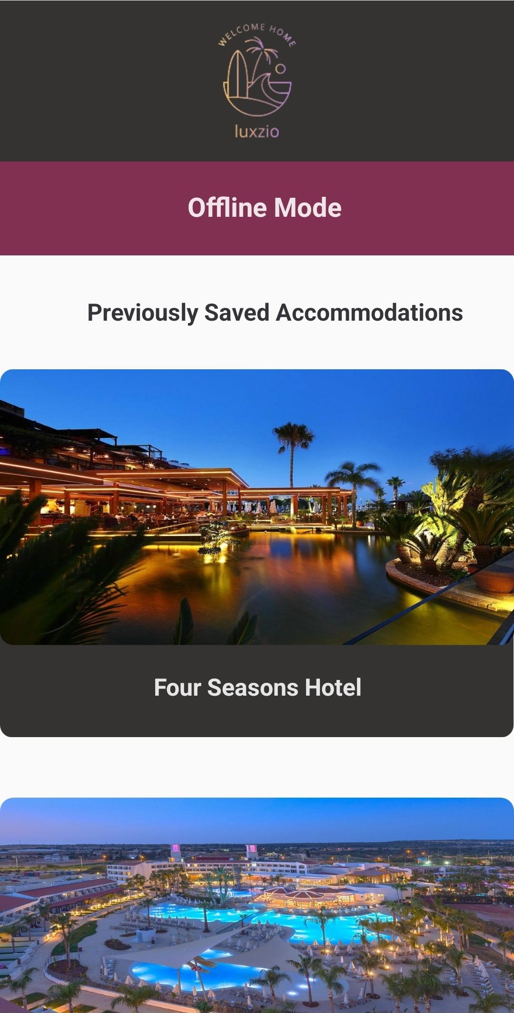
Luxzio Offline Mode
User is being redirected to Offline Mode when there is no Internet Connection

Slide 13
Thank you!

